Slide 1
Europe The Continent Series
VMS Library 2008-2009

Slide 2
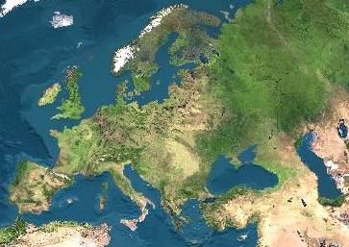
Satellite View

Slide 3
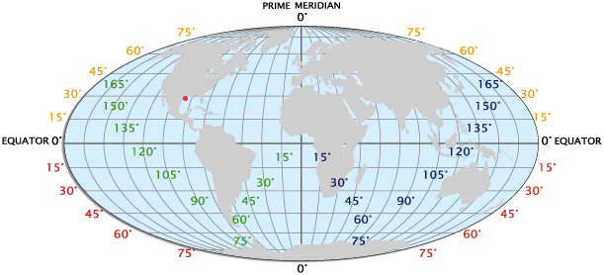
Longitude / Latitude

Slide 4
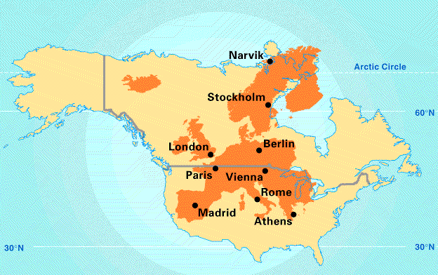
Europe’s Latitude vs. US

Slide 5
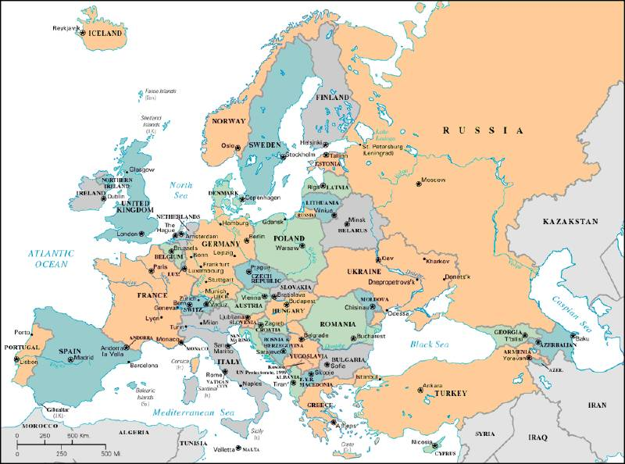
3,800 square miles

Slide 6
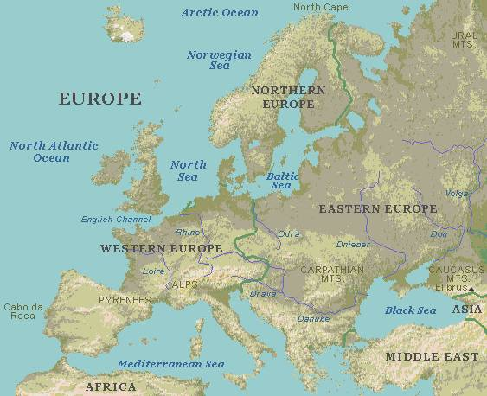
Regions

Slide 7
Northern Peninsulas
Scandinavian Peninsula
Jutland Peninsula

Slide 8
Southern Peninsulas
Crimean Peninsula
Iberian Peninsula
Italian Peninsula
Balkan Peninsula
AnatoleanPeninsula

Slide 9
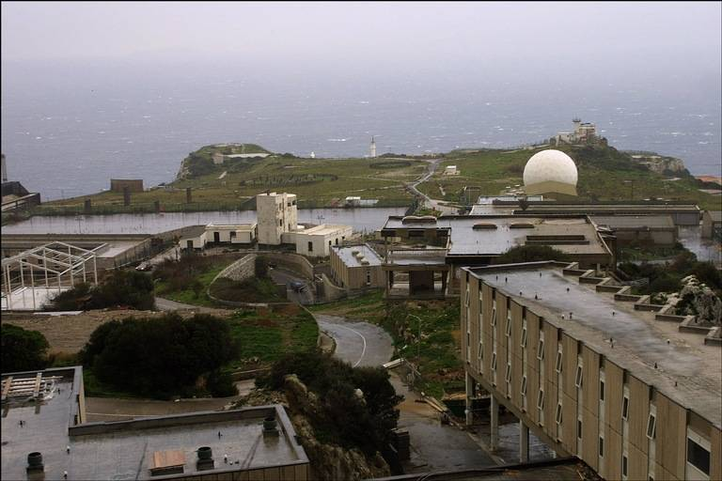
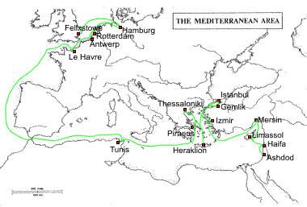
Mediterranean Sea:
Strait of Gibraltar & the “Pillars of Hercules”
2,400 miles long & 1,000 miles wide
“Crossroads of 3 Continents”

Slide 10
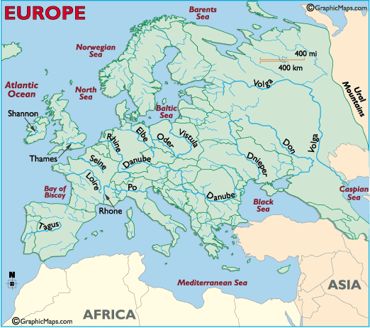
Rivers
Po R.
Tiber R.

Slide 11
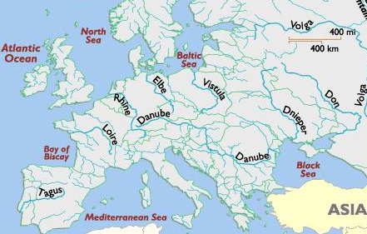
The Danube River
1770 miles

Slide 12
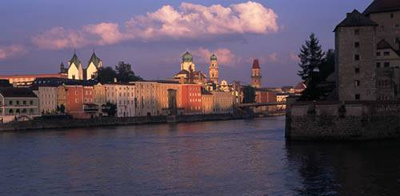
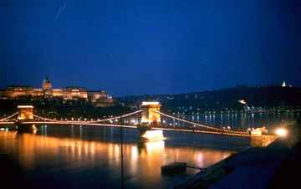
The Danube River
Where Buda & Pest Meet
Flows through the 12 countries of Germany, Austria, Slovakia, Hungary, Serbia, Croatia, Bosnia and Herzegovina, Slovenia, Bulgaria, Romania, and the Ukraine.

Slide 13
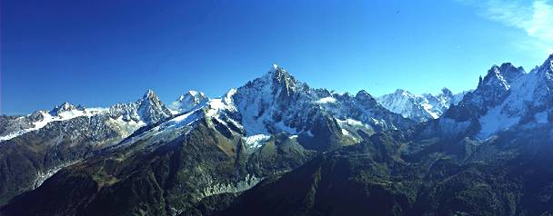
The Alps
Cover most of Switzerland, Austria, and parts of Italy and France.

Slide 14
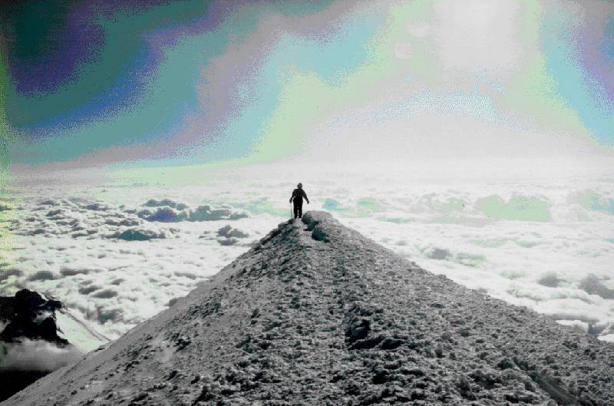
Mt. Blanc in the Alps
Highest mountain in the Alps: 15,771 feet

Slide 15
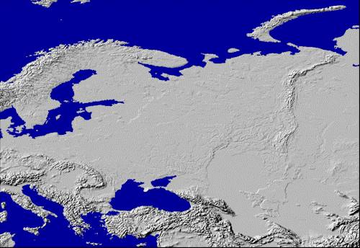
Ural Mountains:The Great Divide
1500 miles
Divides the European and Asian sections of Russia.

Slide 16
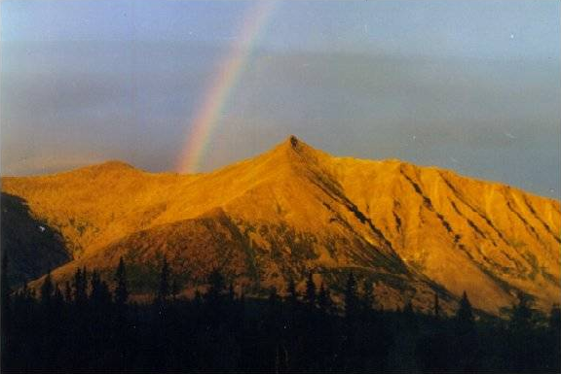
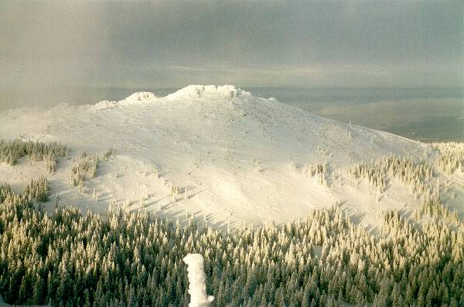
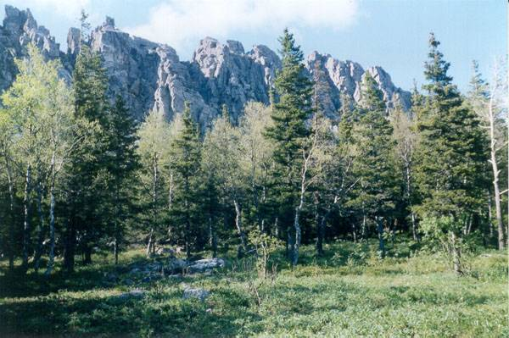
The Ural Mountains

Slide 17
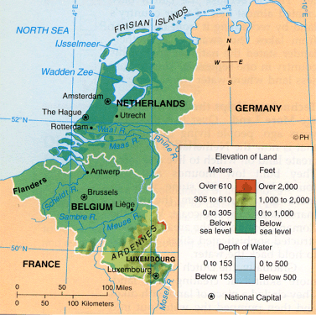
The BENELUX Countries
Belgium
Netherlands
Luxembourg

Slide 18
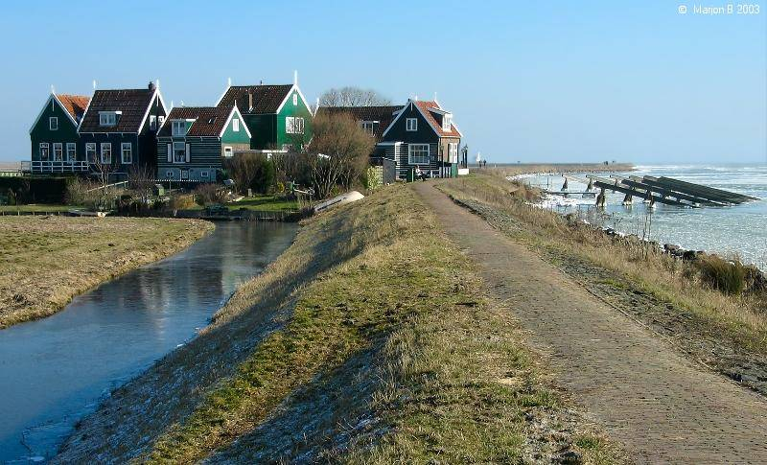
Holland’s Dikes

Slide 19
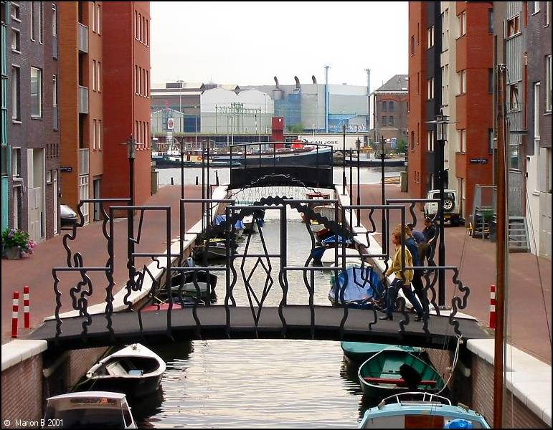
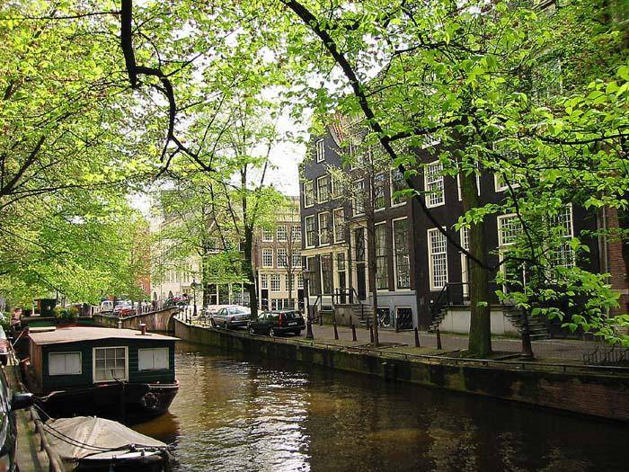
Amsterdam’s Canals

Slide 20
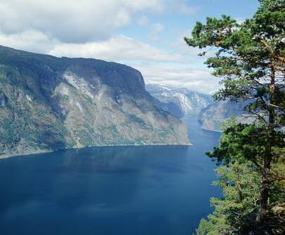
Norwegian Fjords
Glaciers cut deep valleys in the ocean during the Ice Age.

Slide 21
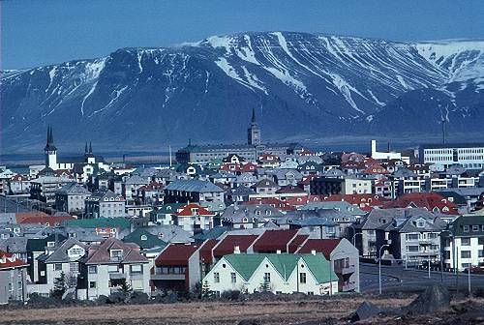
Reykjavik, Iceland: “The Youngest Oldest Country”
Volcanoes
Hot Springs
Geysers

Slide 22
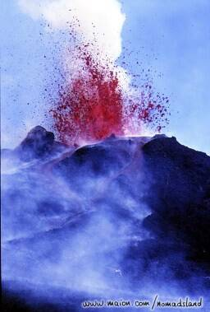
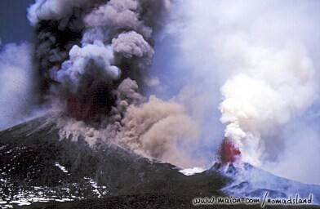
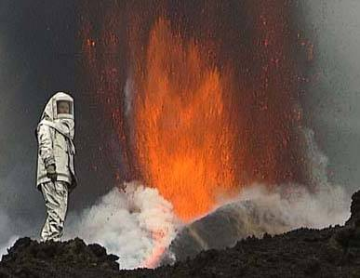
Mt. Etna, Sicily
An active volcano

Slide 23
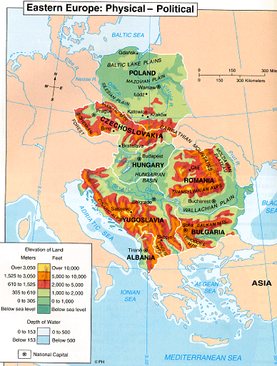
Eastern Europe

Slide 24
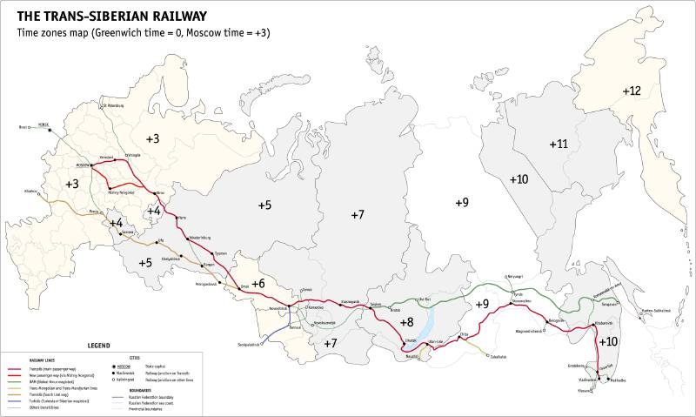
Russia’s 10 Time Zones

Slide 25
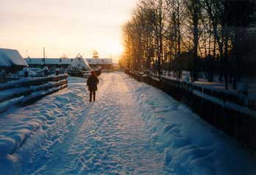
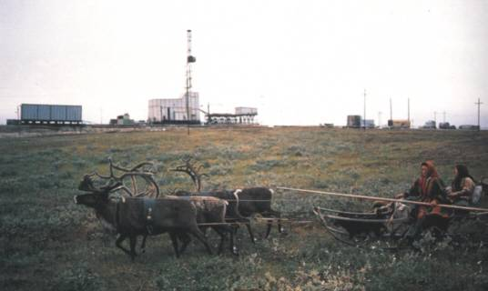
Siberia --> Permafrost
Average temperatures of January vary from 0 to -50°C, and in July from 1 to 25°C
150,000,000 population.

Slide 26
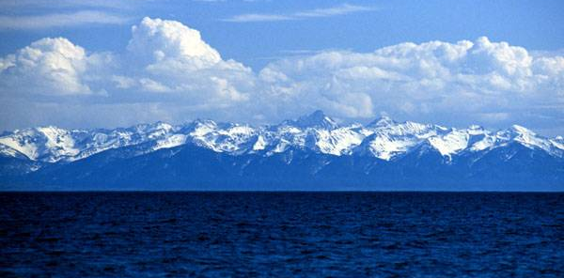
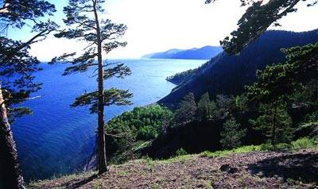
Lake Baikal, Siberia
The oldest and deepest lake in the world.
20% of the world’s total unfrozen water supply.

Slide 27
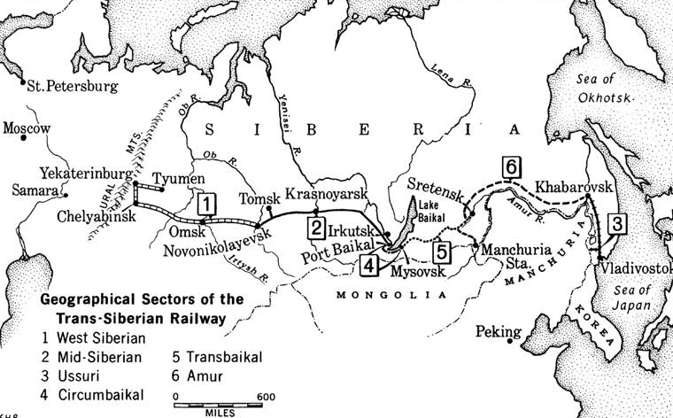
Trans-Siberian Railroad
Completed in 1905

Slide 28
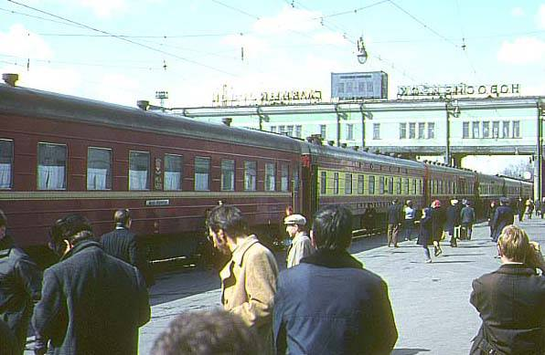
Trans-Siberian Railroad
The main line runs 5,785 miles.

Slide 29
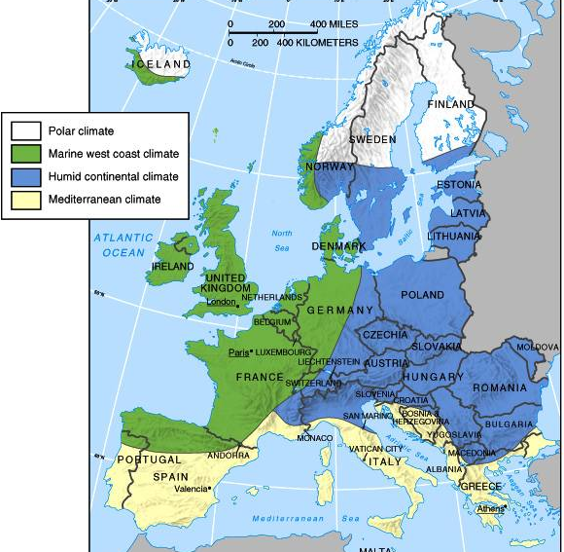
Climate

Slide 30
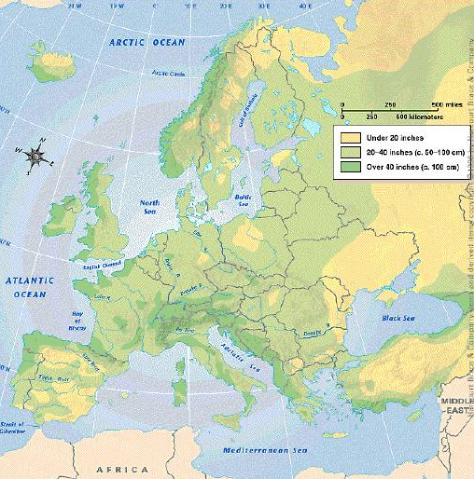
Average Annual Precipitation

Slide 31
Germany’s Black Forest

Slide 32
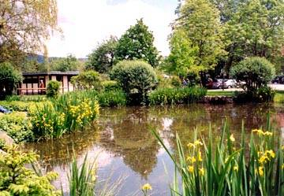
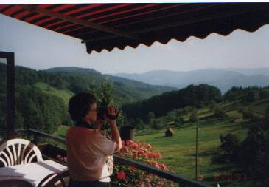
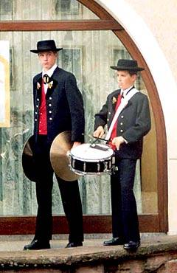
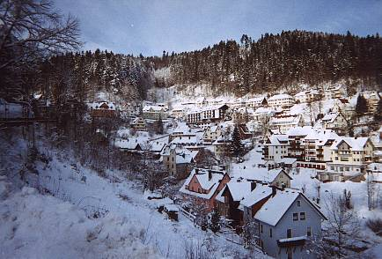
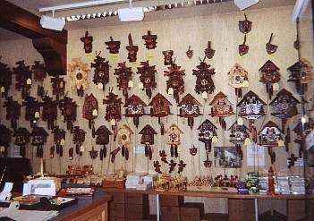
Germany’s Black Forest

Slide 33
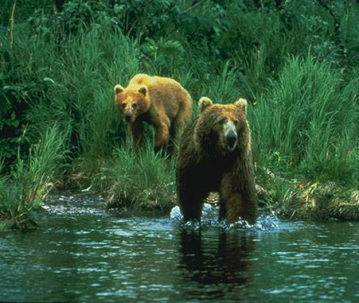
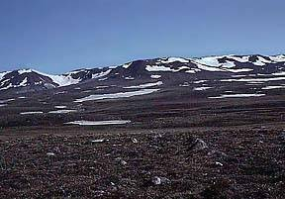
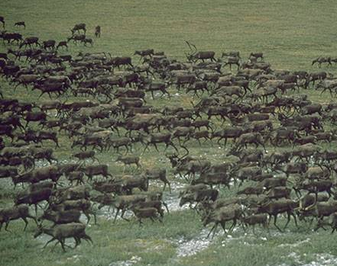
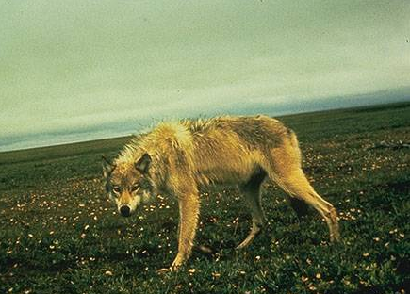
Tundra: The Not-So-Barren Land Below the Arctic Circle

Slide 34
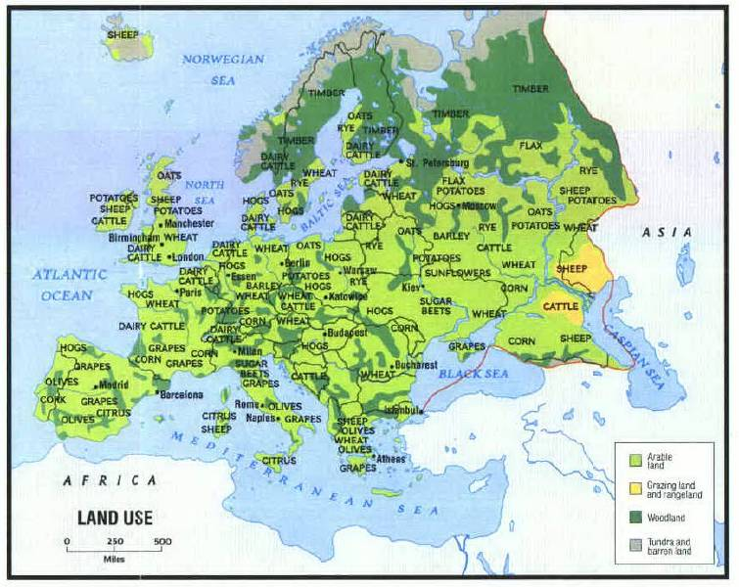
LAND USE

Slide 35
Population Density [People Per Square Mile]
Belgium | 336.82 |  | Mexico | 52.15
Japan | 336.72 |  | United States | 29.77
India | 336.62 |  | World | 14.42
United Kingdom | 244.69 |  | Norway | 14.42
Italy | 192.96 |  | Canada | 3.36
France | 108.09 |  | Russia | 8.61

Slide 36
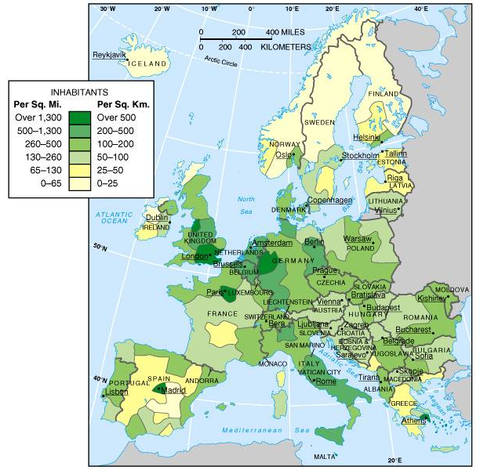
Population Distribution

Slide 37
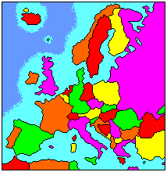
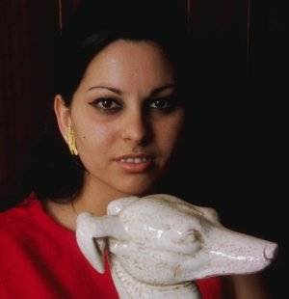
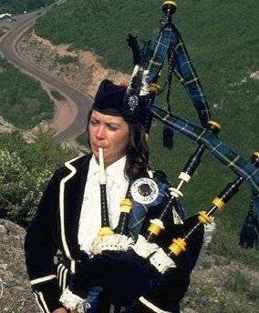
Arrivederci!
Good Bye!
Au Revoir!
Adios!
Cairete!
Auf Wiedersehen!
Do Svidaniya!

Slide 38
This powerpoint was kindly donated to www.worldofteaching.com
http://www.worldofteaching.com is home to over a thousand powerpoints submitted by teachers. This is a completely free site and requires no registration. Please visit and I hope it will help in your teaching.

